Slide 1

Home Loan Default Detector
Shibo Zhao, Lili Chen, Lei Bai, Mingjie Tang, Mingyue Zheng
Data scientist team 1

Slide 2

What are my client's business needs?
Business challenge: when making decision for loan approval, we need to predict whether an applicant is going to default.
Clients: Home Credit
Built a Loan Default Detector based on binary classification machine learning models to maximize the profit.
Our data scientist team

Slide 3

Home Loan Application Data Preview
Data Size
Number of Applications (Entry/Row): Total of 307,511
Applicant/Application Information (Columns) :121 Features + 1 Target
Total Data Size: > 30M Data
Data Type
float64 65
int64 41
object 16

Slide 4
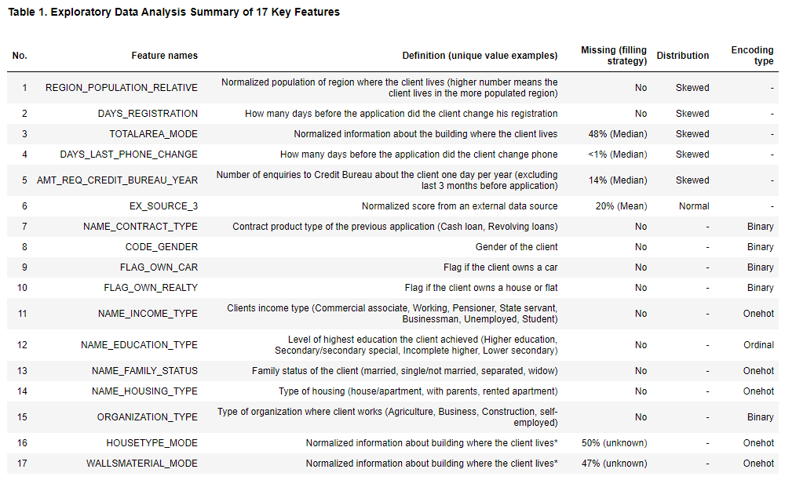
EDA

Slide 5
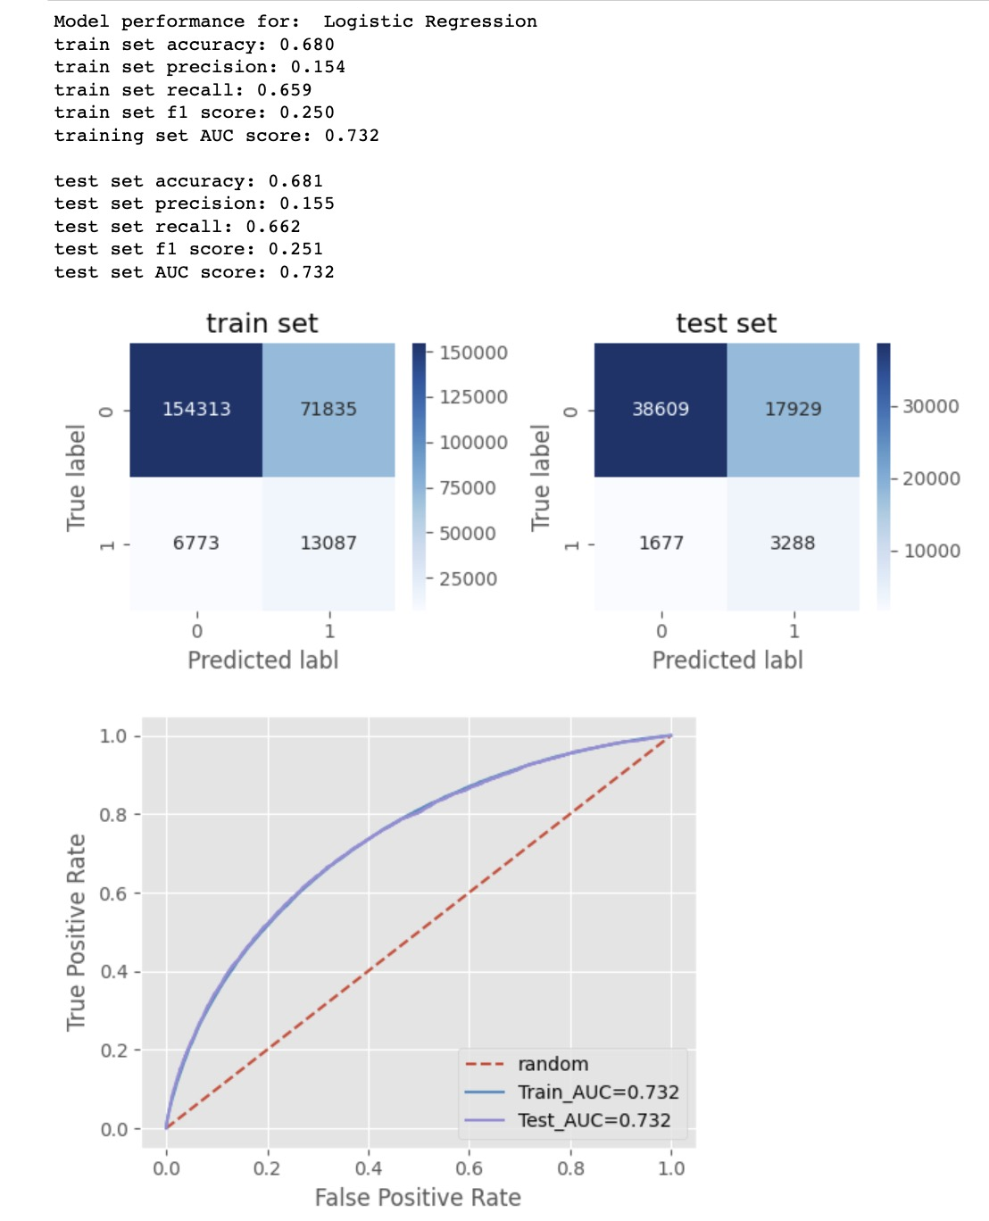
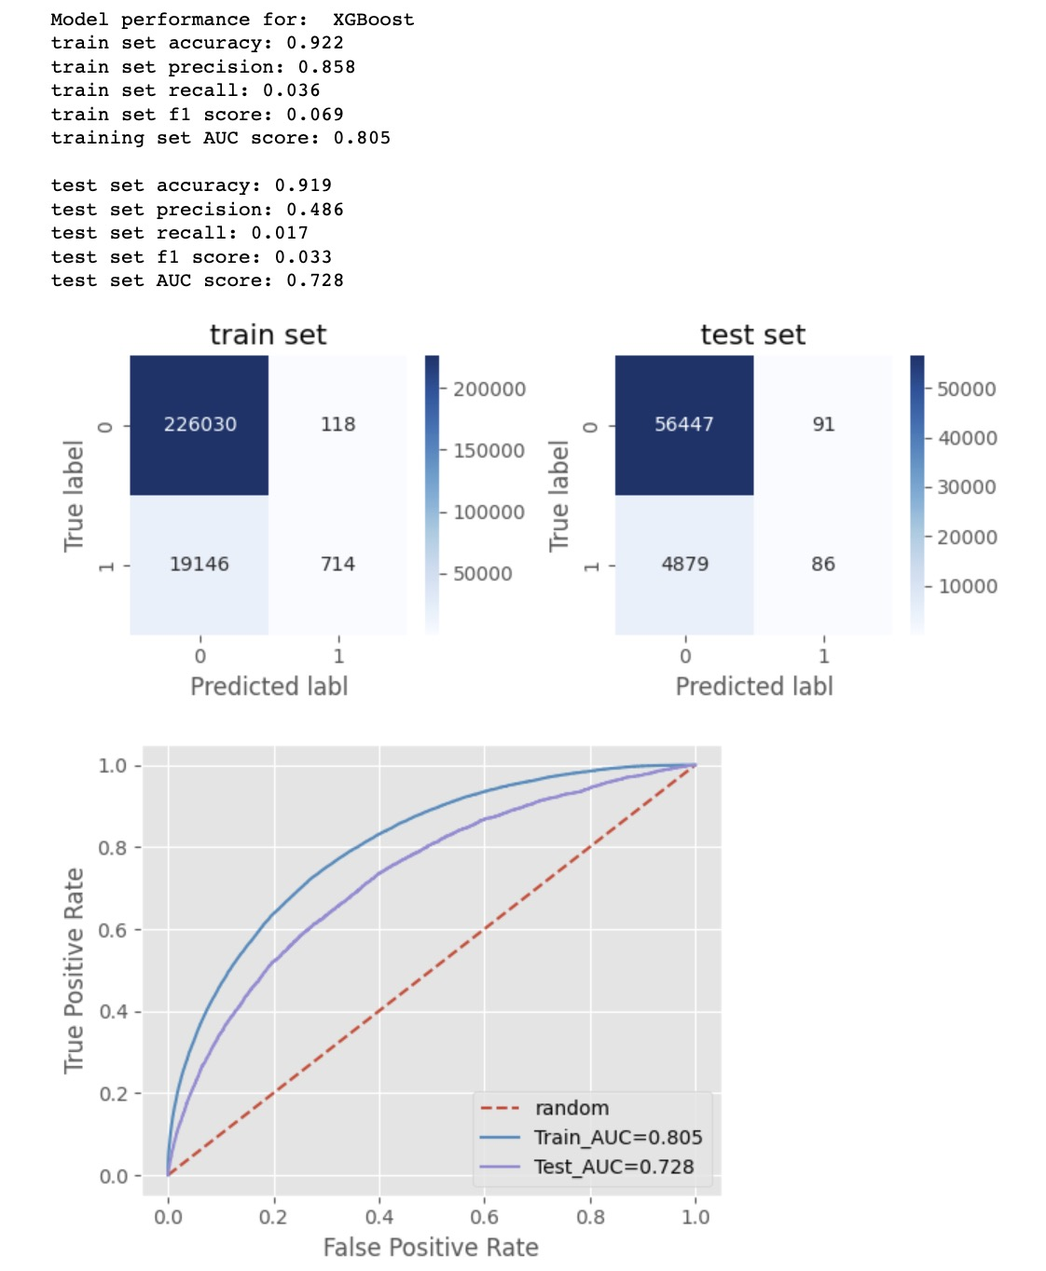
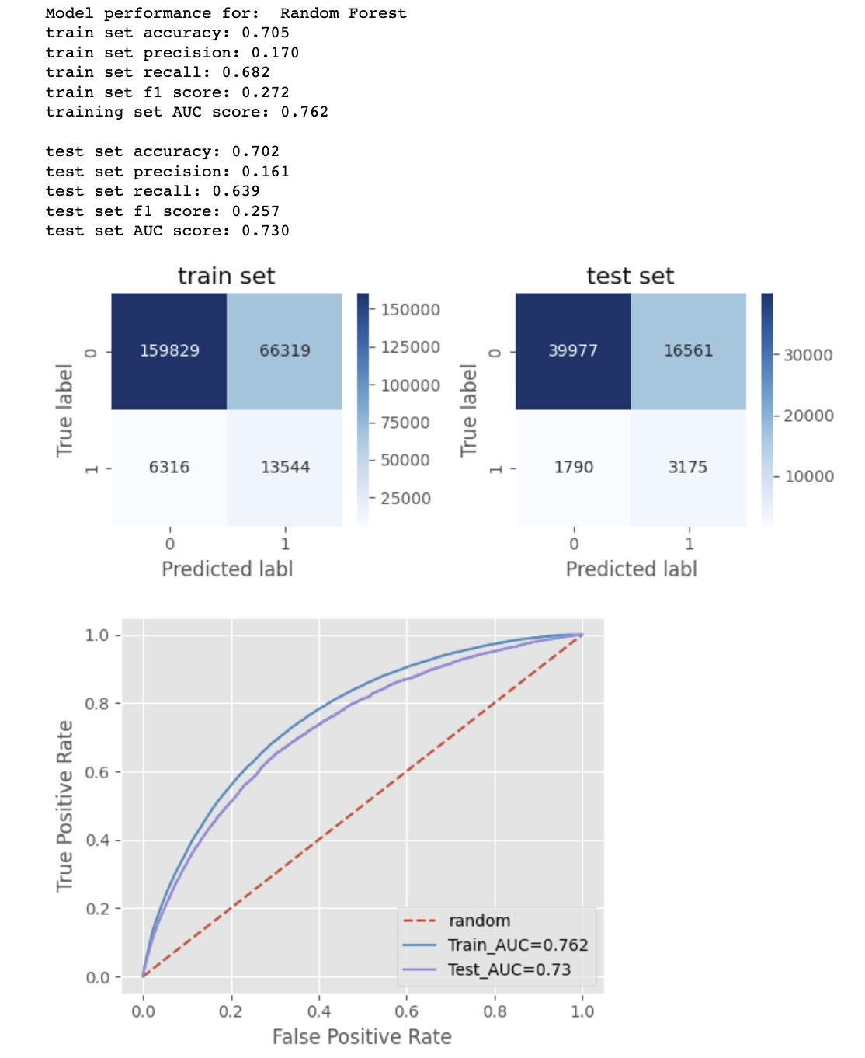
Modeling

Slide 6
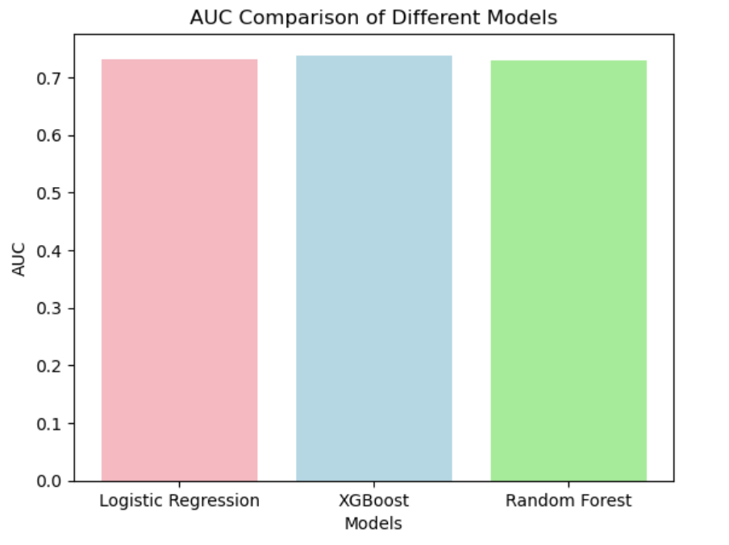
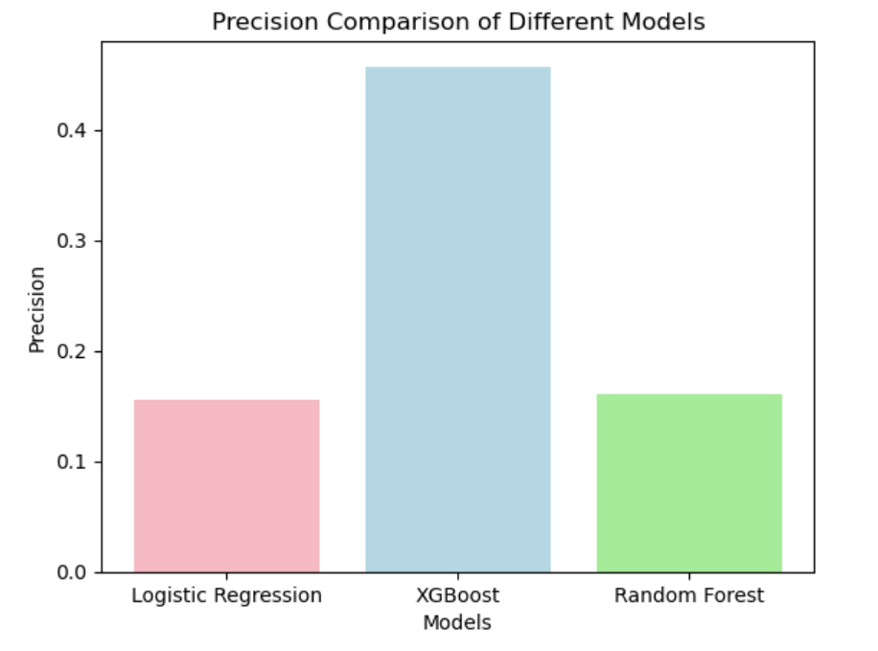
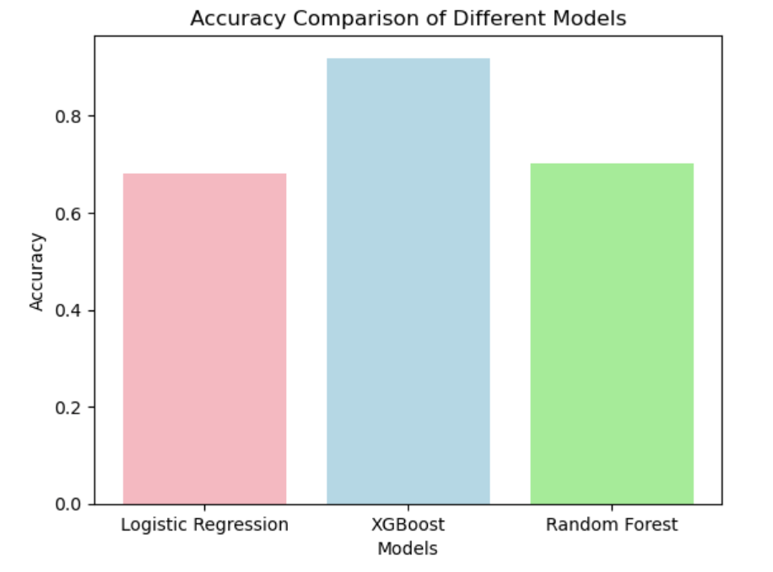
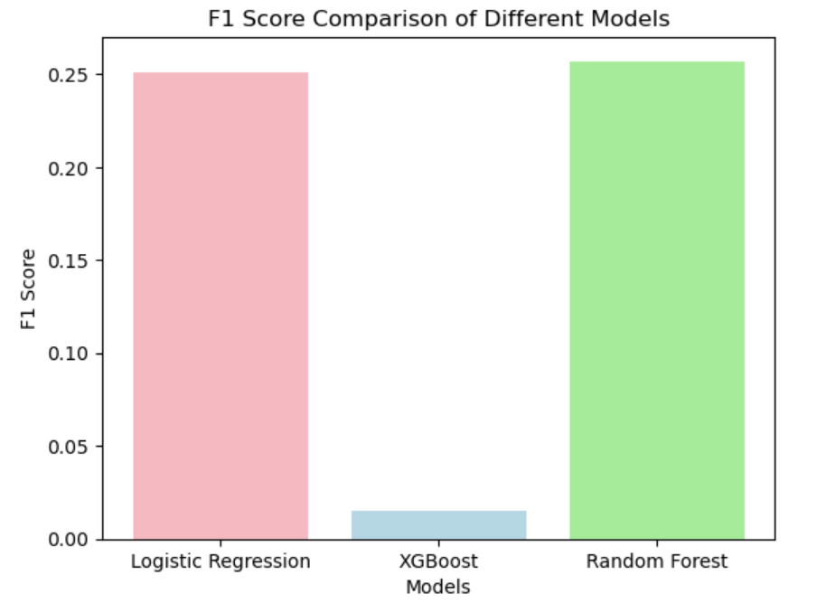
Metrics for Three Models

Slide 7
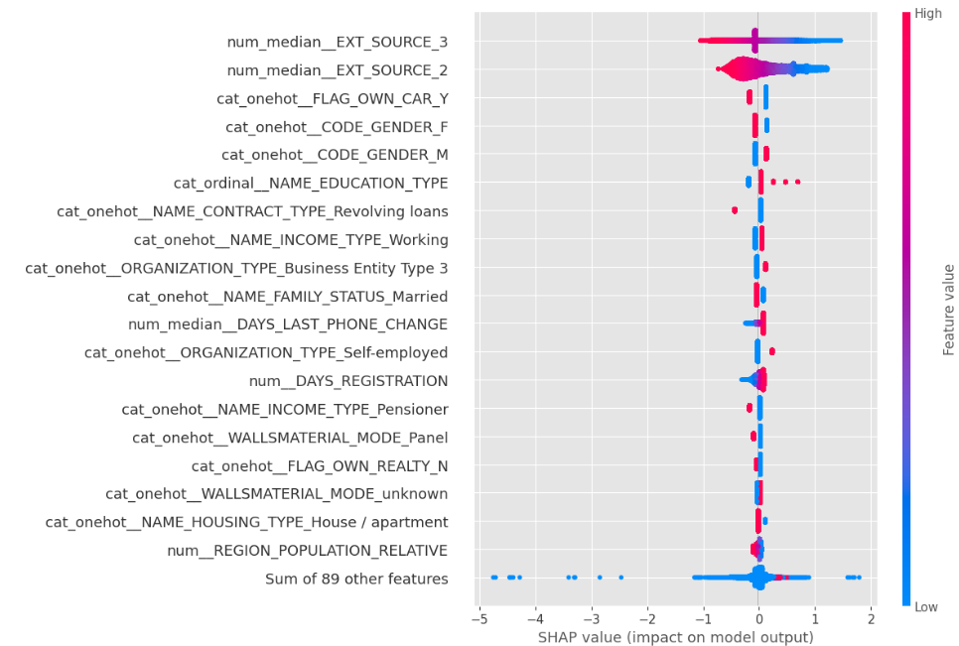
Feature Importance

Slide 8
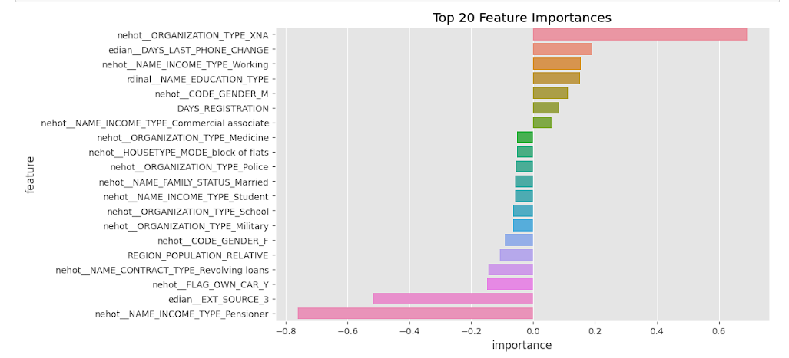


Feature Importance
These features have a lower influence in predicting bad loans.
Good loans: being a pensioner, having a car, and higher external credit score
Organization type (Unknown vs others)
Days since the last phone change (in the last 12 months)
Income type (Working vs Unemployed)
Education type (Academic degrees vs Lower secondary)

Slide 9
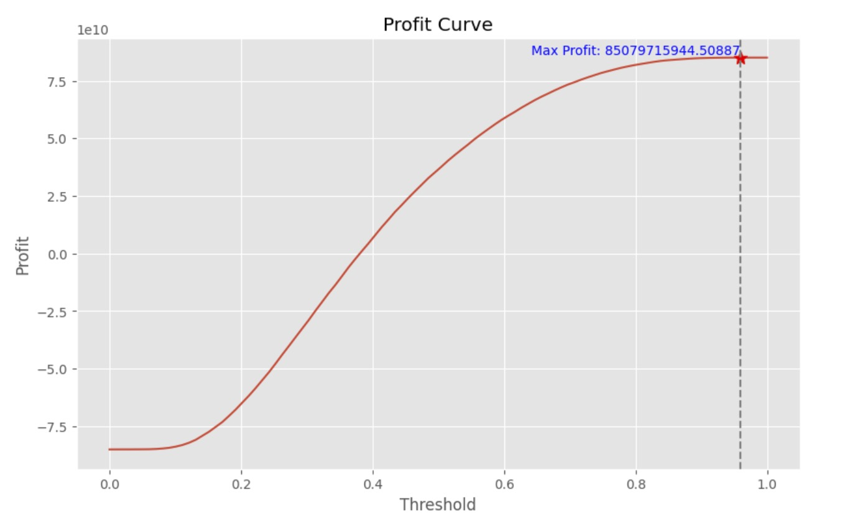
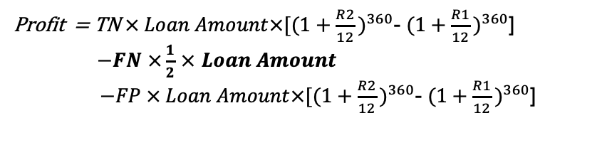
30 years
8 billion net profit
Profit Curve and Implied Threshold
1) Scenario 1
Profit maximization threshold=0.939
Max profit=8 billion
Confusion Matrix: [[56538 0]
[ 4965 0]]
Implications: Issue loans to all customers given current test data
Default rate=FN/(TN+FN)=7.9%
2) Scenario 2
If: Threshold = 0.5
Confusion Matrix: [[37015 19523]
[1799 3166]
Default rate=FN/(TN+FN)=4.6%
Profit=4 billion
Profit = TN$× Loan Amount{×[(1+\frac{R2}{12}\text{)}}^{360}$- ${(1+\frac{R1}{12}\text{)}}^{360}$]
$−FN$ $×\frac{1}{2}$ $×$ $Loan Amount$
$−FP × Loan Amount{×[(1+\frac{R2}{12}\text{)}}^{360}$- ${(1+\frac{R1}{12}\text{)}}^{360}$]

Slide 10
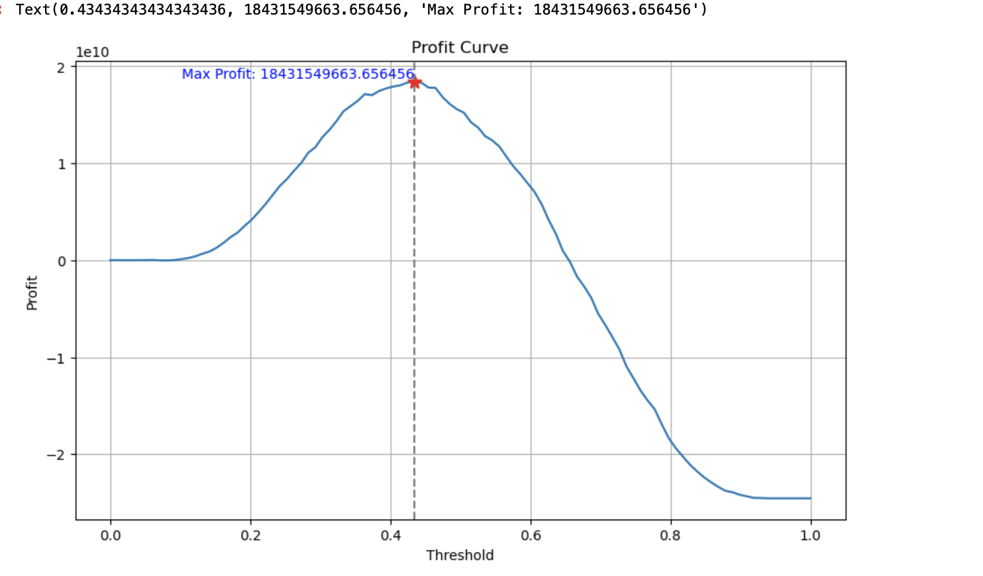
Test our profit function by
increasing FN
Dramatically

Slide 11
What did we do for our clients?
Optimal Metrics
Logistic Regression, XGBoost, Random Forest were evaluated by AUC, Precision, Accuracy, Recall, F1 score.
LR was selected as the best model.
Data visualization (EDA)
Preprocessing Data
Modelling
The expected max net profit is 8 billion (30 years).

Slide 12
Final product
Business challenge: when making a decision for loan approval, we need to predict whether an applicant is going to default.
Clients: Home Credit
http://34.122.185.185:8501

Slide 13
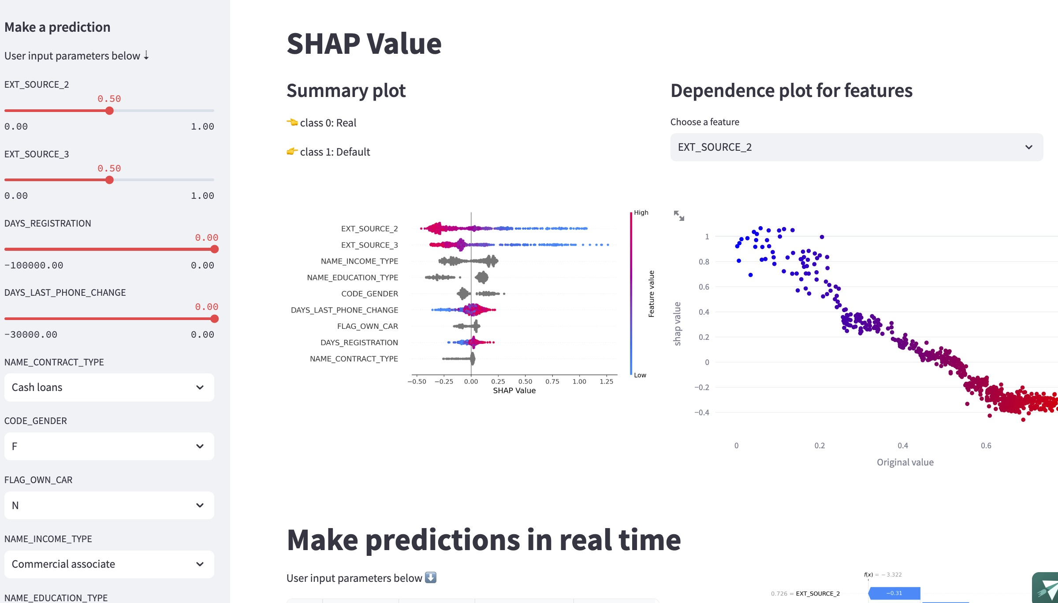

Slide 14
Executive Summary
Business challenge: when making a decision for loan approval, we need to predict whether an applicant is going to default.
Built a Loan Default Detector based on binary classification machine learning models to maximize the profit.
The expected max net profit is 8 billion (30 years).
Data visualization (EDA), Preprocessing, Modeling with machine learning were performed.
Logistic Regression, XGBoost, Random Forest were evaluated by AUC, Precision, Accuracy, Recall, F1 score. LR was selected as the best model.
The most important features for the model are EXT_SOURCE, OWN_CAR, EDUCATION_TYPE, etc. (Top 20 are listed)
Model is deployed at http://34.122.185.185:8501

Slide 15

Thank You！
Questions?

